Slide 1

Web Scraping to
PyMySQL

Slide 2
Web Scraping
Web scraping is the process of automatically extracting data from websites. It involves fetching the content of a web page and parsing it to retrieve specific information, such as text, images, links, or tables.
    Tools and Libraries.
    Legal and Ethical Considerations.
    How Web Scraping Works

Slide 3
Tools and Libraries
Python Libraries: Popular libraries for web scraping include BeautifulSoup, Scrapy, and Selenium.
Scrapy: A powerful and flexible scraping framework used for large-scale scraping projects.
Selenium: Often used for scraping dynamic content generated by JavaScript because it can interact with a web page like a human user would.

Slide 4
Legal and Ethical Considerations
Terms of Service: Always review the website's terms of service to ensure that scraping is allowed.
Robots.txt: Check the robots.txt file of the website to understand what parts of the site are off-limits for scraping.
Ethical Scraping: Scrape responsibly without overloading the server, and respect the privacy and intellectual property of the website owner.

Slide 5
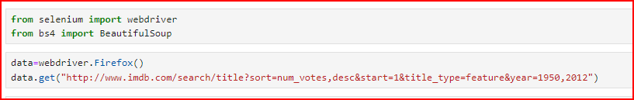
How Web Scraping Works
Fetching the Web Page: The scraper sends a request to the server hosting the website (typically using the HTTP or HTTPS protocol) and receives the HTML content of the page in response.

Slide 6
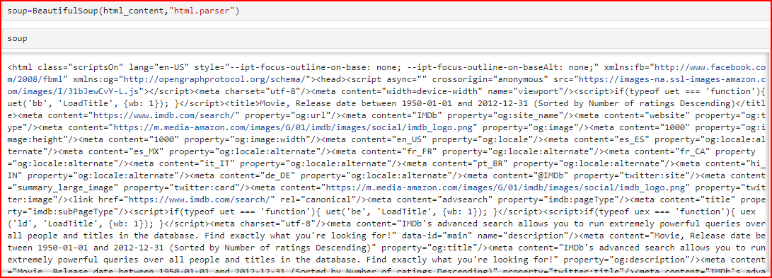
Parsing the Content: The HTML content is then parsed using a tool or library (like BeautifulSoup in Python) to identify and extract the specific data of interest.

Slide 7
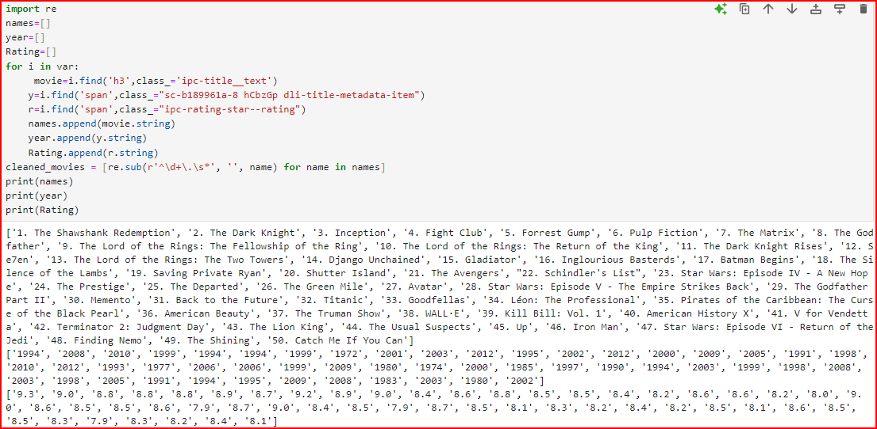
Data Extraction: The scraper locates the specific elements (e.g., paragraphs, headings, tables, images) on the page that contain the desired data and extracts it.

Slide 8
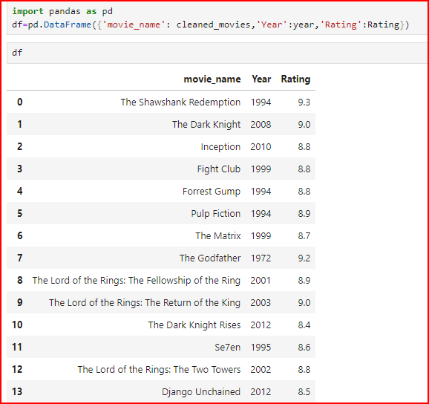
Storing the Data: The extracted data can stored in various formats such as CSV, Excel, a database, or directly used in an application.

Slide 9
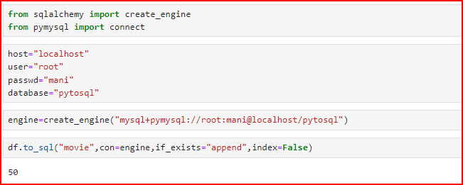
Storing Data in MySQL
Once you've scraped the data, you can store it in a MySQL database. PyMySQL is a Python library that allows you to connect to a MySQL database and execute SQL queries.

Slide 10
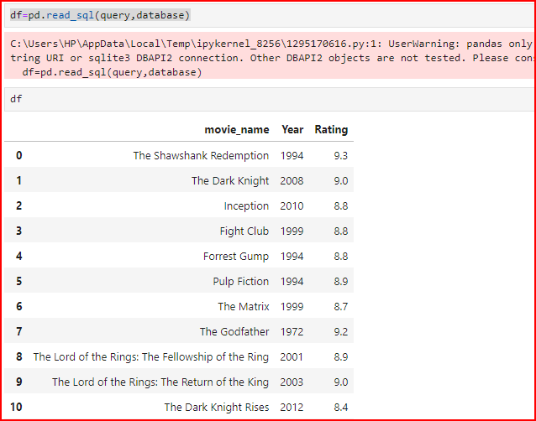
Insert DataFrame into MySQL
The pandas library to execute a SQL query and directly load the results into a DataFrame. This is a very efficient way to work with SQL data in Python, especially if you're planning to perform data analysis or manipulation.

Slide 11
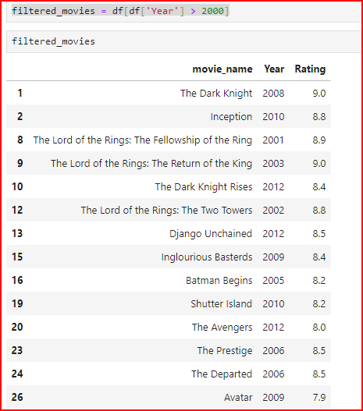
Filter data for specific
filtering refers to the process of selecting a subset of data that meets certain criteria. Filtering allows you to narrow down your data set by applying specific conditions, so you only work with the data that is relevant to your needs.

Slide 12
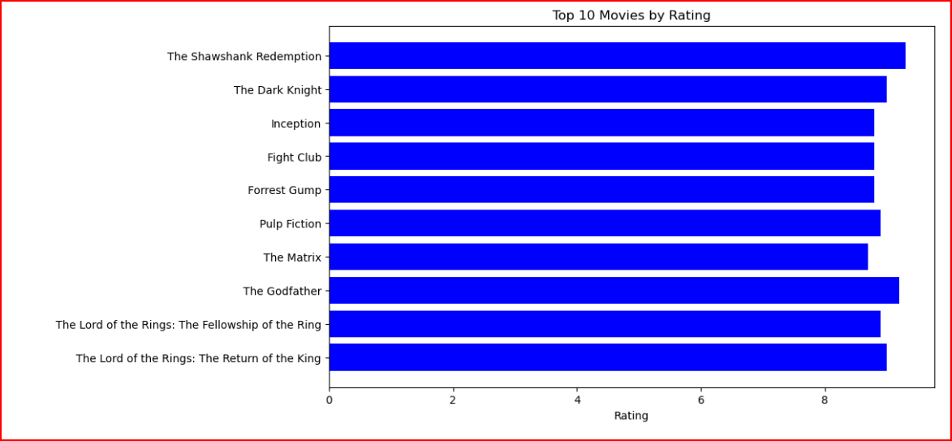
Data Visualiation
bar plot (or bar chart): is a graphical representation of categorical data where individual bars represent the values of different categories. It is commonly used to compare the sizes, frequencies, or amounts of different categories visually.

Slide 13
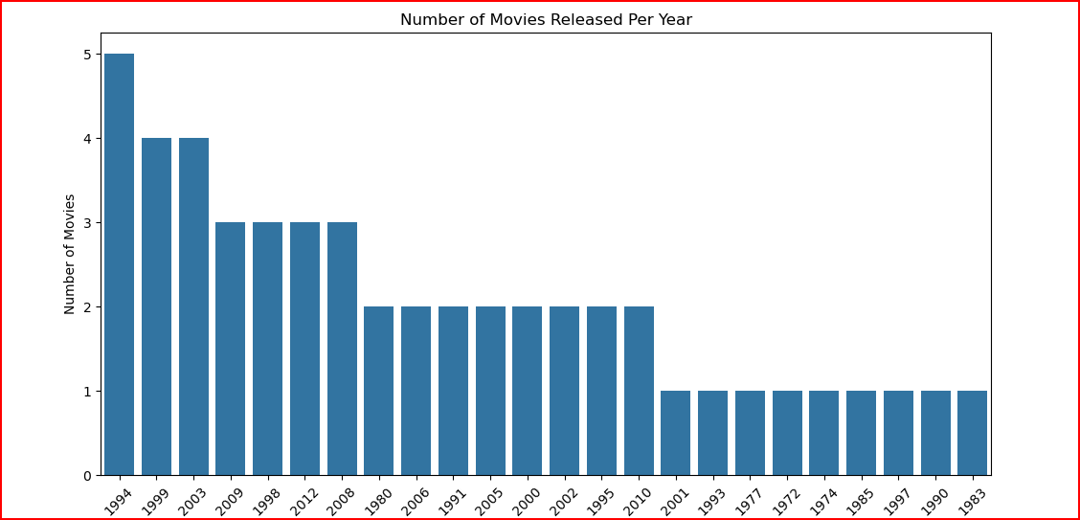
A count plot is a type of bar plot that displays the counts of observations in each category of a categorical variable. It provides a visual representation of the frequency of each category in the dataset, making it easy to compare the size of different groups.

